Slide 1
Week - 4 Agile ISM 6930 – 3 Credit Hours Special Topics (Agile Project Management - APM) Spring, 2018; Room: A205 (12:00pm to 2:45pm) Dr. Bhuvan UNHELKAR IT Faculty, College Of Business; Office: C225; bunhelkar@sar.usf.edu; 941-359-4654

Slide 2
Agenda
The
"Agile job aids" (Selected Agile Practices).
Study of Agile Practice :
Summary & Consolidation

Slide 3
Sub-Module Certifications
Options and Thoughts?
© MethodScience; Material Designed and Presented by Dr. B. Unhelkar; drawn from The Art of Agile Practice

Slide 4
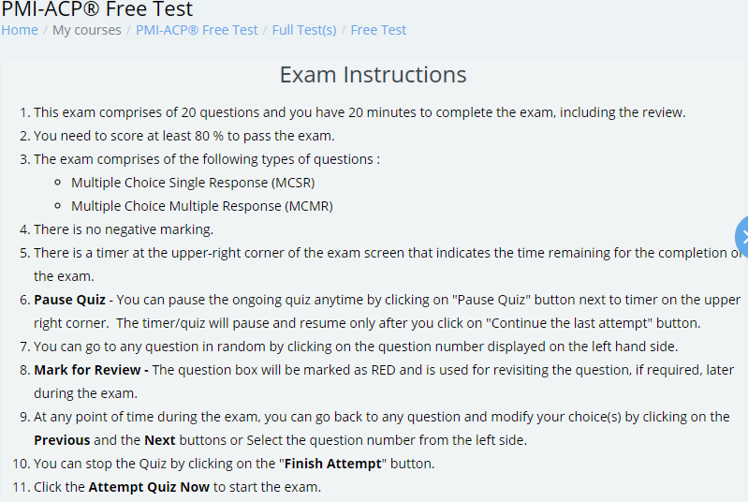
https://learning.whizlabs.com/mod/quiz/view.php?id=5240

Slide 5
https://www.whizlabs.com/professional-scrum-master-i/
4. Professional Scrum Master Certification
Professional Scrum Master (PSM) is one of the top IT certifications that is gaining popularity among software developers and project managers. Professional Scrum Master Certification is for the individuals who want to validate their in-depth knowledge of Scrum. There are three levels of the PSM certification, PSM I, PSM II, and PSM III. At each level, one needs to pass an assessment to get industry-recognized PSM certifications that will demonstrate his/her skills in Scrum. You need to study hard to pass the PSM certification exam as with each level, the difficulty level of the exam also increases. The significant details and information about all the three levels of Professional Scrum Master (PSM) Certification exam are –
PSM I Exam Overview
Certification Name – Professional Scrum Master I (PSM I)
Prerequisites for the Exam – None, but Associate’s or Bachelor’s degree or Equivalent with some experience in Scrum is recommended
Exam Pattern – Multiple Choice, Multiple Answer, and True-False Questions
Number of Questions – 80
Exam Duration – 60 minutes (1 hour)
Exam Fee – $150
Passing Score – 85%
Renewal – Not required
Exam Objectives
The Scrum Framework
Scrum Principles and Theory
Cross-functional and Self-organizing teams
Facilitation and Coaching
Scrum at Large
PSM II Exam Overview
Certification Name – Professional Scrum Master II (PSM II)
Prerequisites for the Exam – None, but PSM I is the recommended certification
Exam Pattern – Multiple Choice, Multiple Answer, and True-False Questions
Number of Questions – 30
Exam Duration – 90 minutes (1.5 hours)
Exam Fee – $250
Passing Score – 85%
Renewal – Not required
Exam Objectives
Facilitation and Coaching
Scaling Fundamentals
Self-organizing and Cross-Functional teams
Product Backlog Management
Maximization of Values
Scrum Framework – Rules and Roles
Scrum Principles and Theory (PSM II)
Scrum Values and Agile Principles
PSM III Exam Overview
Certification Name – Professional Scrum Master III (PSM III)
Prerequisites for the Exam – None, but PSM I and PSM II are the recommended certifications
Exam Pattern – Multiple Choice, Multiple Answer, True False Questions, and Essay Type Questions
Number of Questions – 30
Exam Duration – 120 minutes (2 hours)
Exam Fee – $500
Passing Score – 85%
Renewal – Not required
Exam Objectives
Facilitation and Coaching
Self-organizing and Cross-Functional teams
Scrum Framework – Rules and Roles
Scrum Principles and Theory (PSM III)
Average Salary
The average earning of a professional scrum master is $100,000 per annum. Although the range of pay for entry-level to the top-level positions is $73,000 – $126,000 per year.
Want to become a Professional Scrum Master? Start with Level I PSM certification. Take PSM I Free Test now.
Notes:
4. Professional Scrum Master Certification
Professional Scrum Master (PSM) is one of the top IT certifications that is gaining popularity among software developers and project managers. Professional Scrum Master Certification is for the individuals who want to validate their in-depth knowledge of Scrum. There are three levels of the PSM certification, PSM I, PSM II, and PSM III. At each level, one needs to pass an assessment to get industry-recognized PSM certifications that will demonstrate his/her skills in Scrum. You need to study hard to pass the PSM certification exam as with each level, the difficulty level of the exam also increases. The significant details and information about all the three levels of Professional Scrum Master (PSM) Certification exam are –
PSM I Exam Overview
Certification Name – Professional Scrum Master I (PSM I)
Prerequisites for the Exam – None, but Associate’s or Bachelor’s degree or Equivalent with some experience in Scrum is recommended
Exam Pattern – Multiple Choice, Multiple Answer, and True-False Questions
Number of Questions – 80
Exam Duration – 60 minutes (1 hour)
Exam Fee – $150
Passing Score – 85%
Renewal – Not required
Exam Objectives
The Scrum Framework
Scrum Principles and Theory
Cross-functional and Self-organizing teams
Facilitation and Coaching
Scrum at Large
PSM II Exam Overview
Certification Name – Professional Scrum Master II (PSM II)
Prerequisites for the Exam – None, but PSM I is the recommended certification
Exam Pattern – Multiple Choice, Multiple Answer, and True-False Questions
Number of Questions – 30
Exam Duration – 90 minutes (1.5 hours)
Exam Fee – $250
Passing Score – 85%
Renewal – Not required
Exam Objectives
Facilitation and Coaching
Scaling Fundamentals
Self-organizing and Cross-Functional teams
Product Backlog Management
Maximization of Values
Scrum Framework – Rules and Roles
Scrum Principles and Theory (PSM II)
Scrum Values and Agile Principles
PSM III Exam Overview
Certification Name – Professional Scrum Master III (PSM III)
Prerequisites for the Exam – None, but PSM I and PSM II are the recommended certifications
Exam Pattern – Multiple Choice, Multiple Answer, True False Questions, and Essay Type Questions
Number of Questions – 30
Exam Duration – 120 minutes (2 hours)
Exam Fee – $500
Passing Score – 85%
Renewal – Not required
Exam Objectives
Facilitation and Coaching
Self-organizing and Cross-Functional teams
Scrum Framework – Rules and Roles
Scrum Principles and Theory (PSM III)
Average Salary
The average earning of a professional scrum master is $100,000 per annum. Although the range of pay for entry-level to the top-level positions is $73,000 – $126,000 per year.
Want to become a Professional Scrum Master? Start with Level I PSM certification. Take PSM I Free Test now.

Slide 6
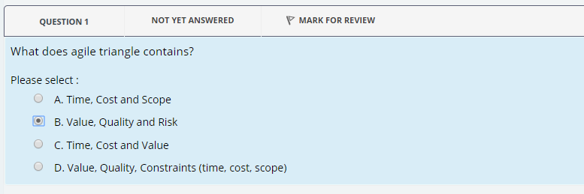

Slide 7
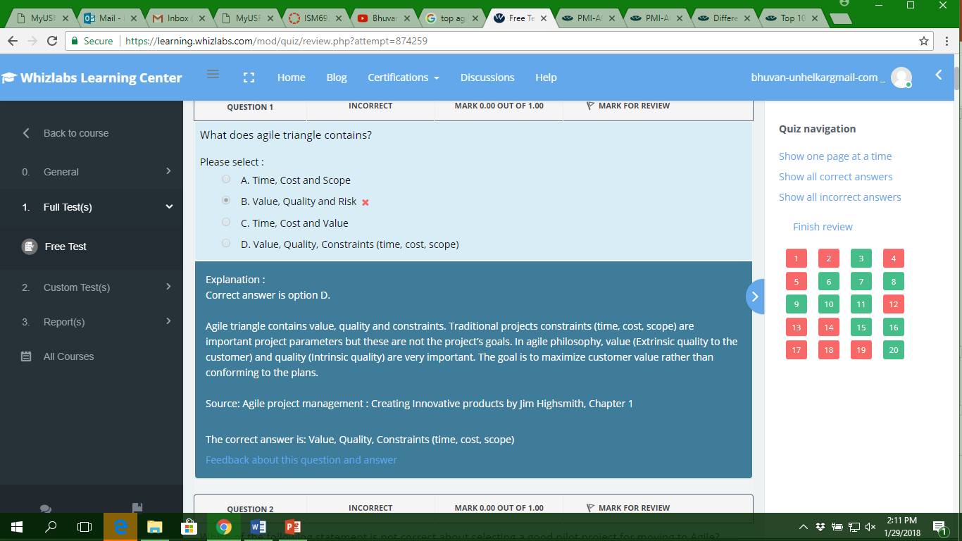

Slide 8
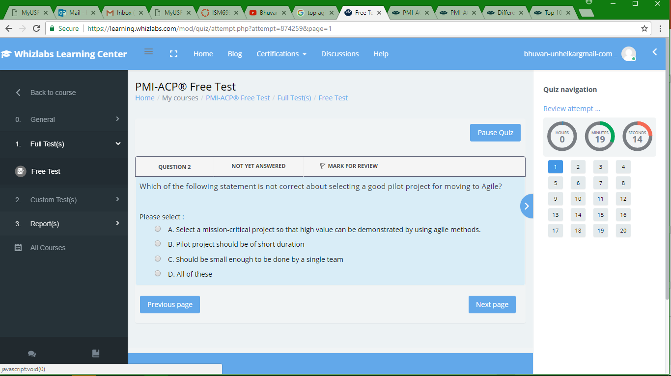

Slide 9
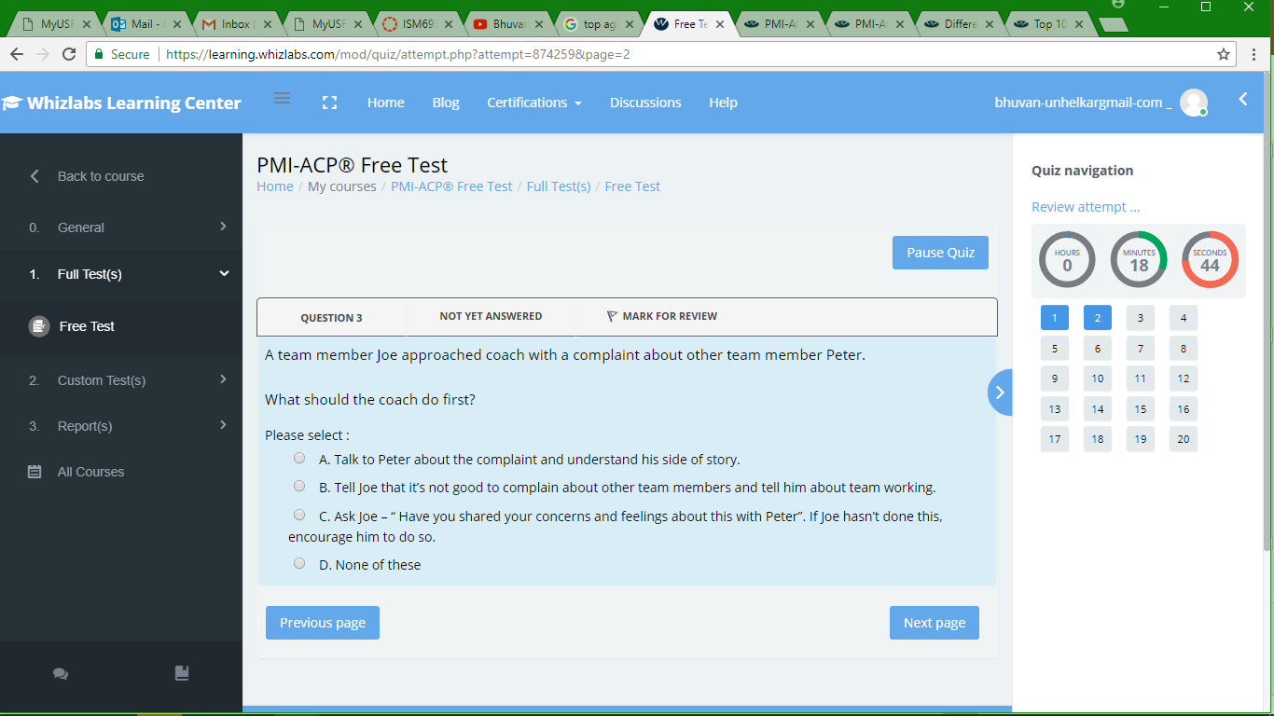

Slide 10
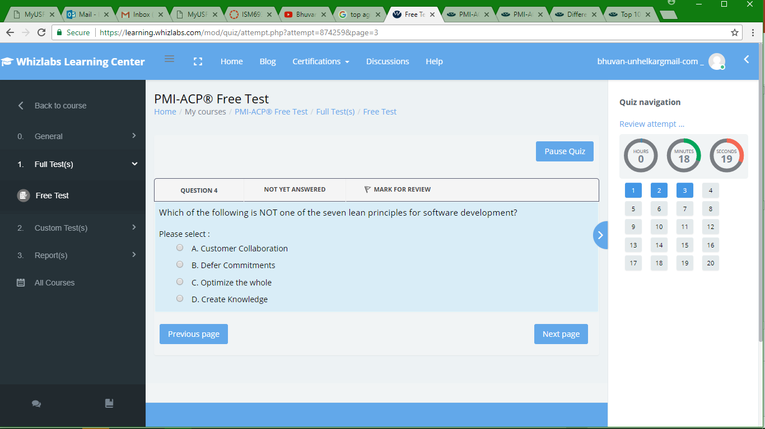

Slide 11
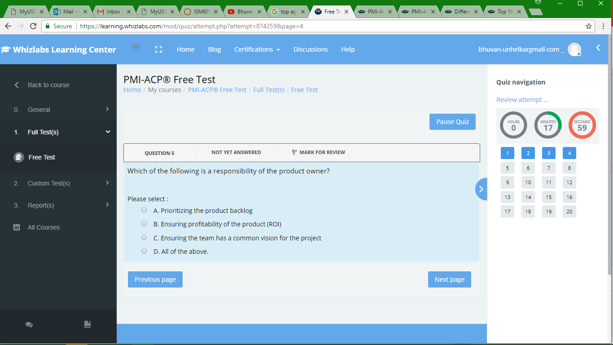

Slide 12
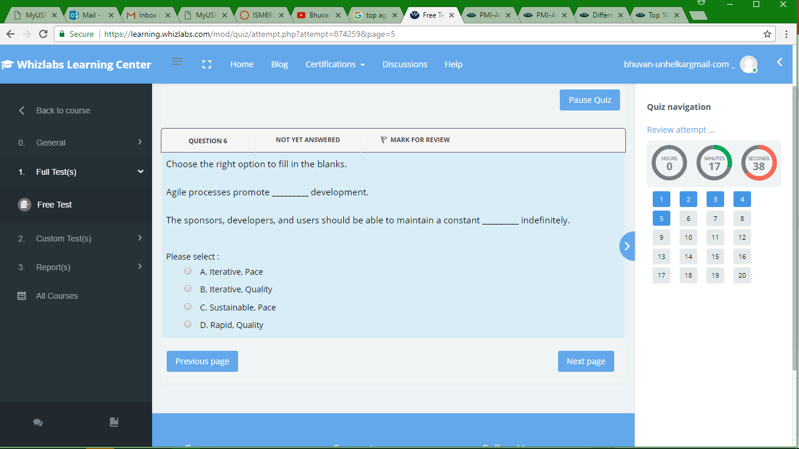

Slide 13
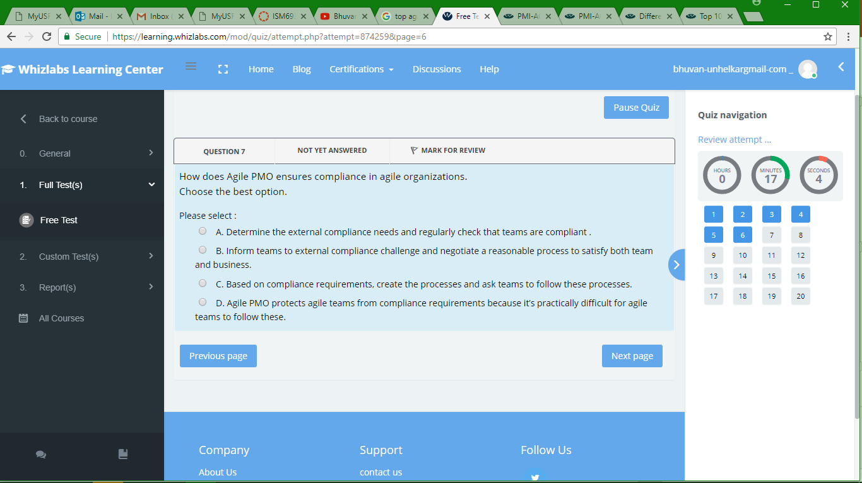

Slide 14
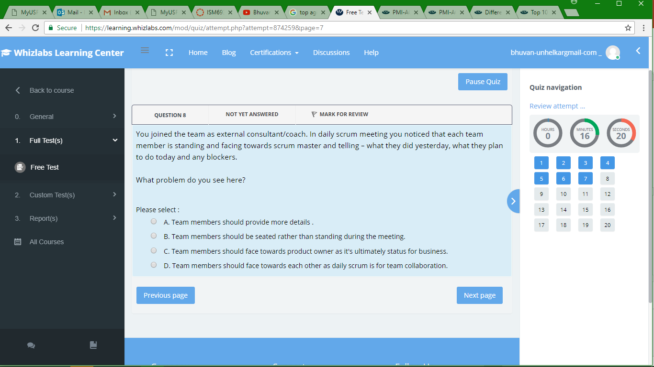

Slide 15
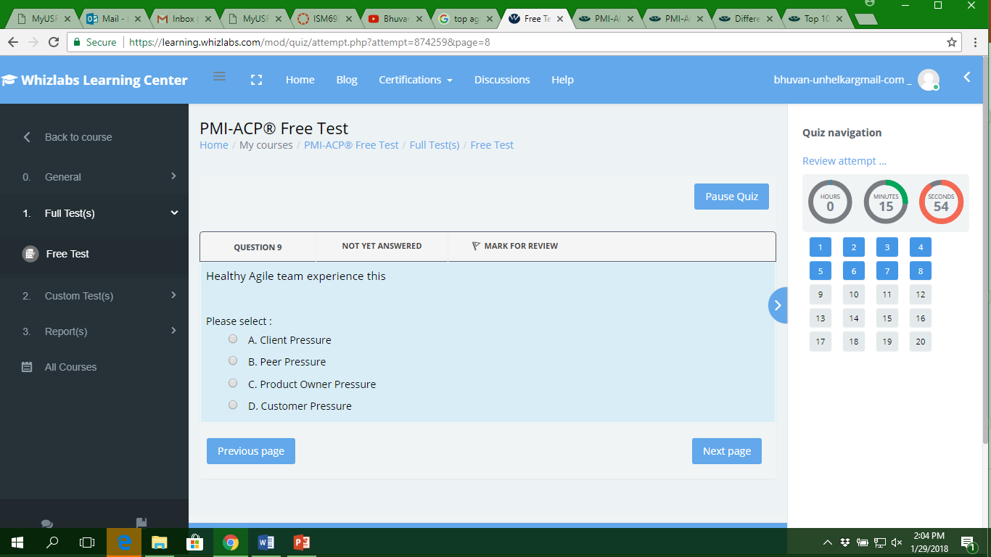

Slide 16
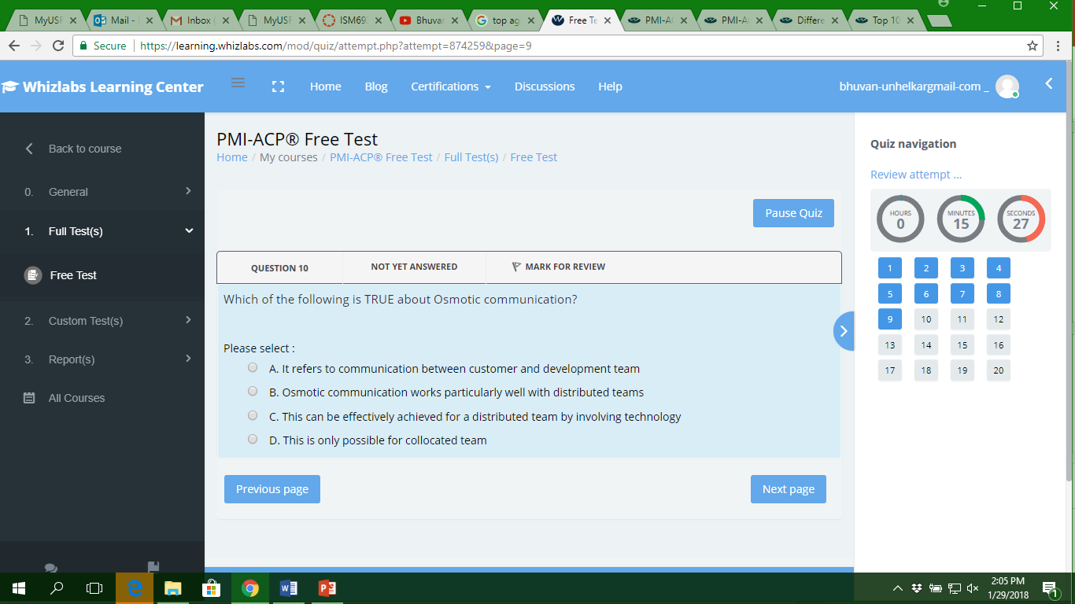

Slide 17
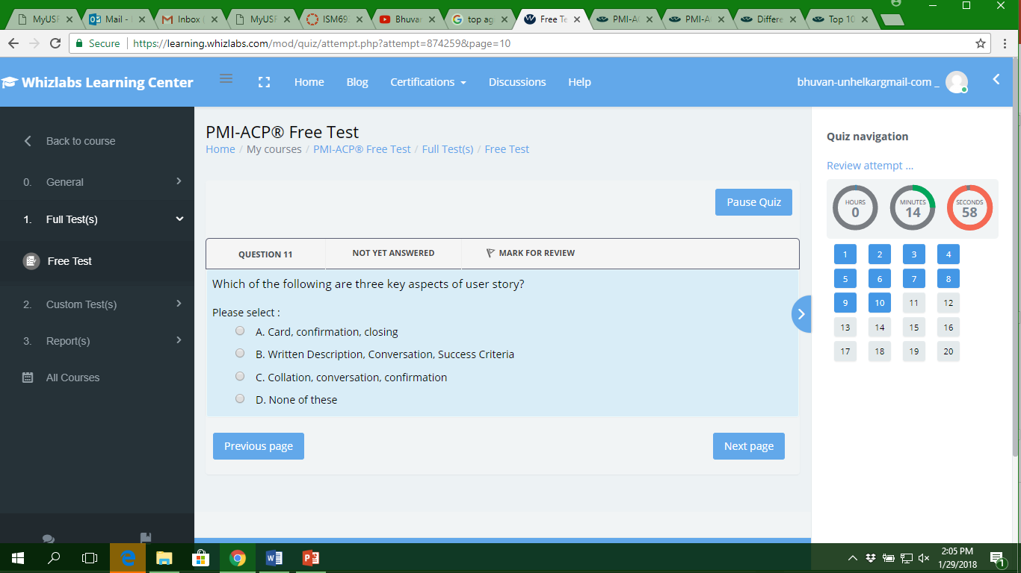

Slide 18
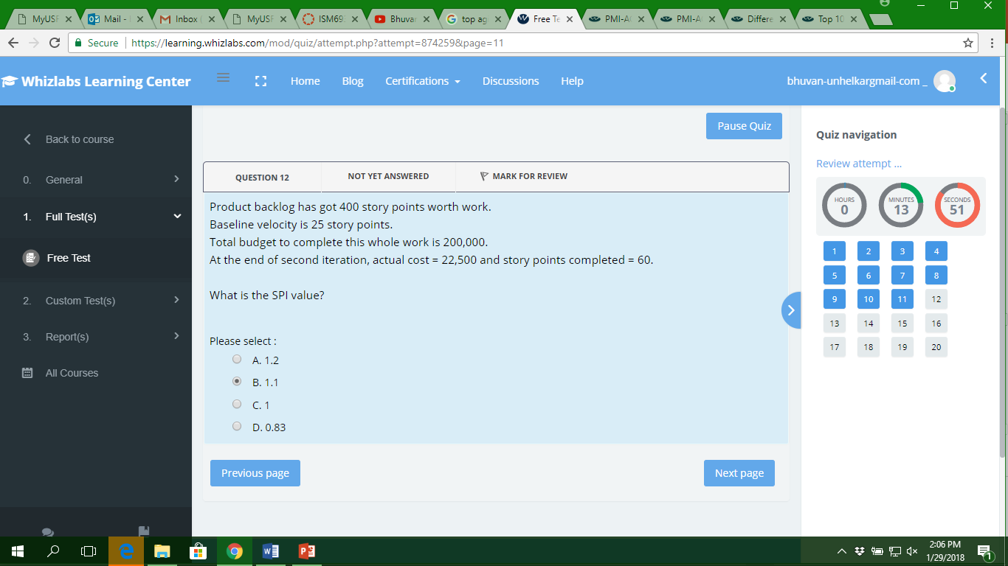

Slide 19
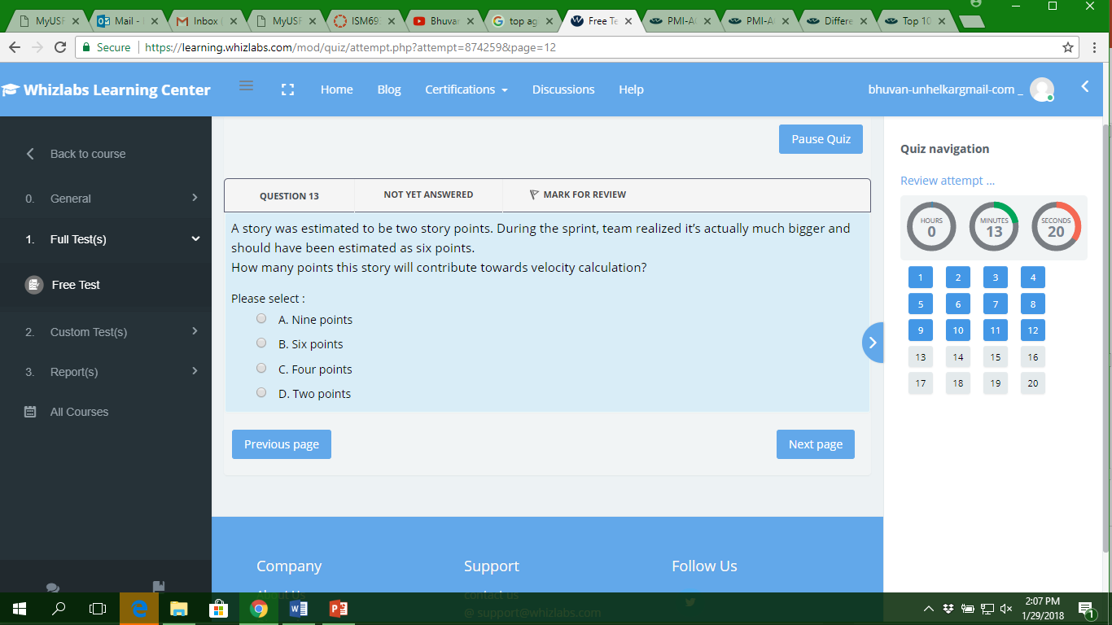

Slide 20
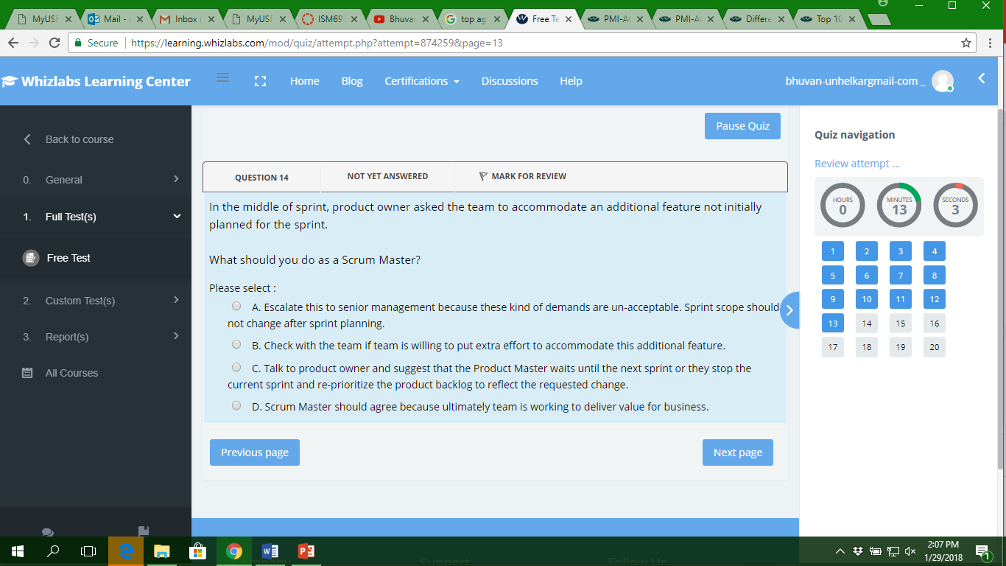

Slide 21
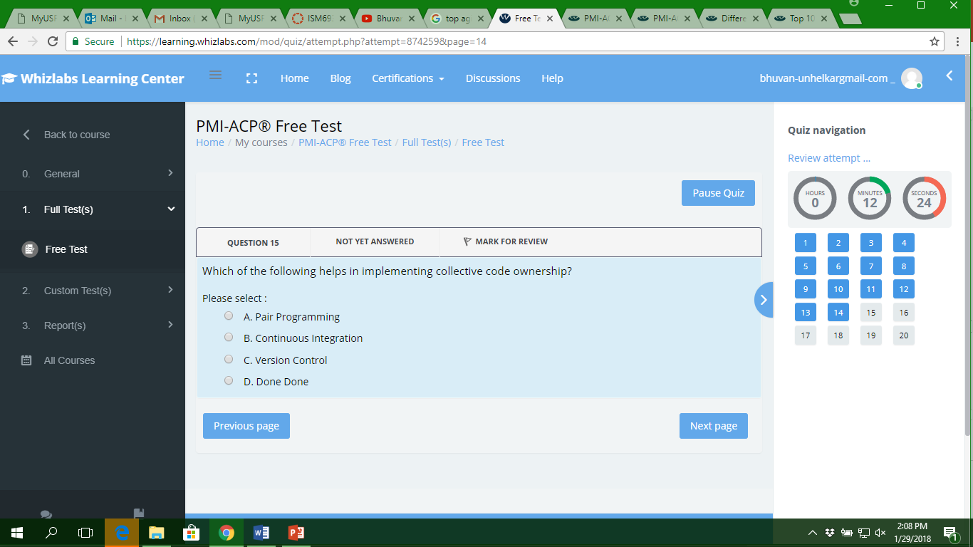

Slide 22
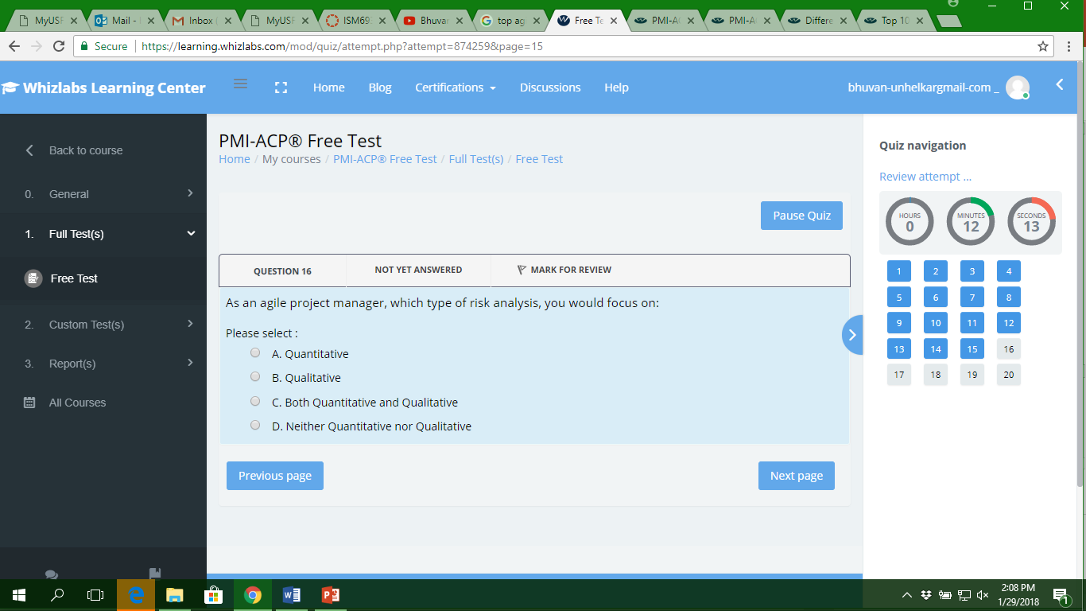

Slide 23


Slide 24
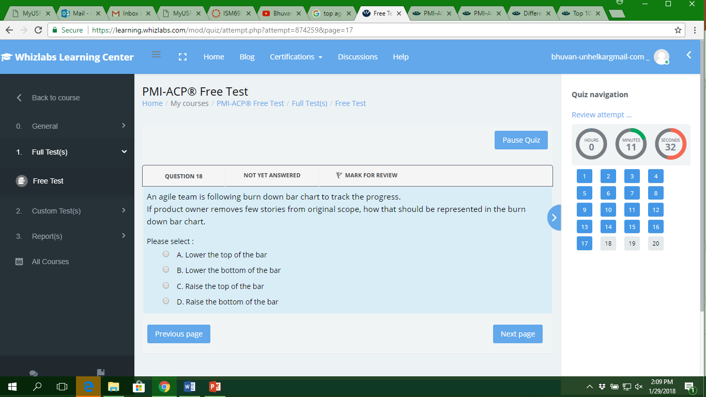

Slide 25
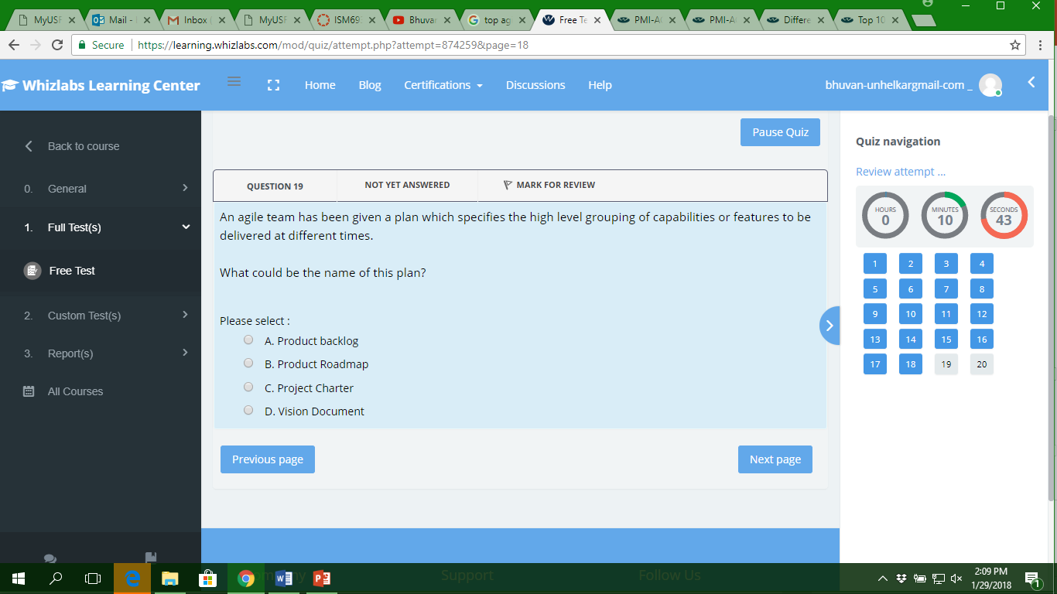

Slide 26
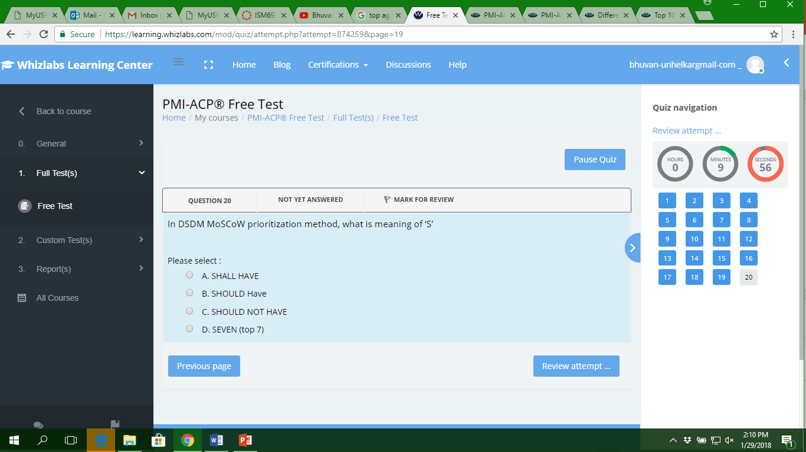

Slide 27
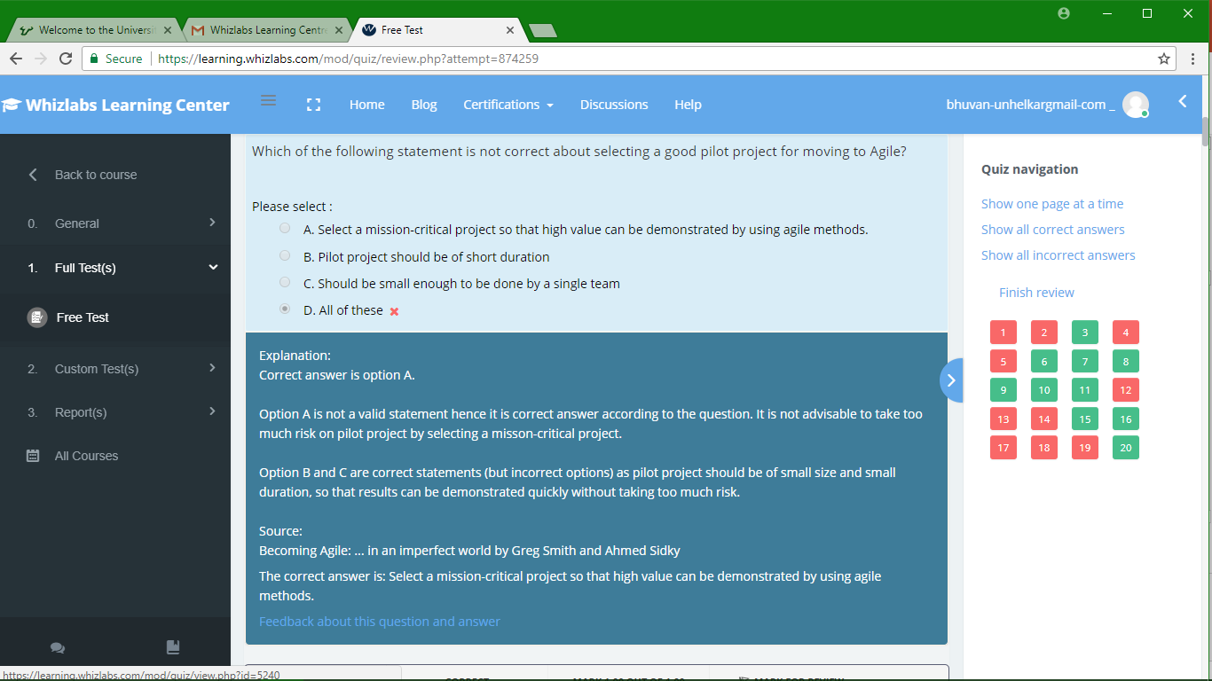

Slide 28
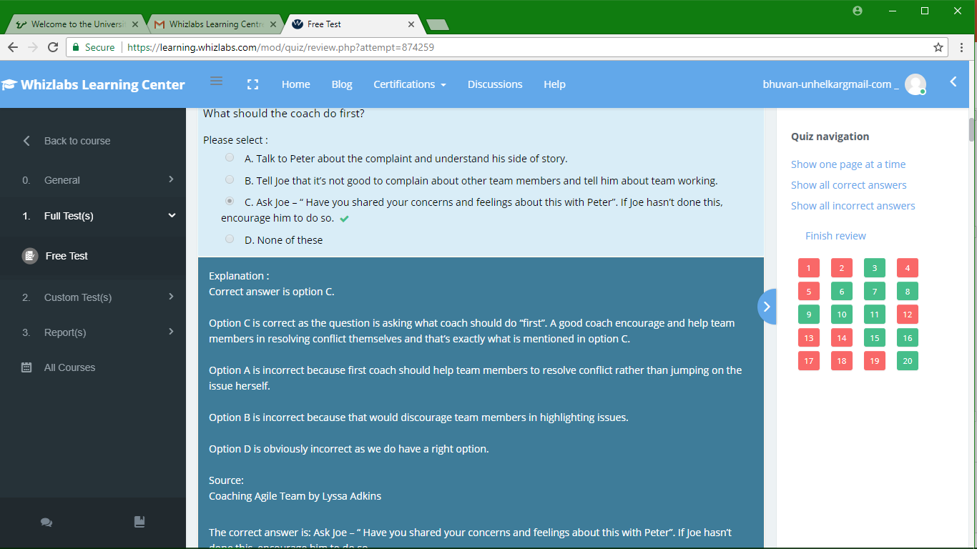

Slide 29
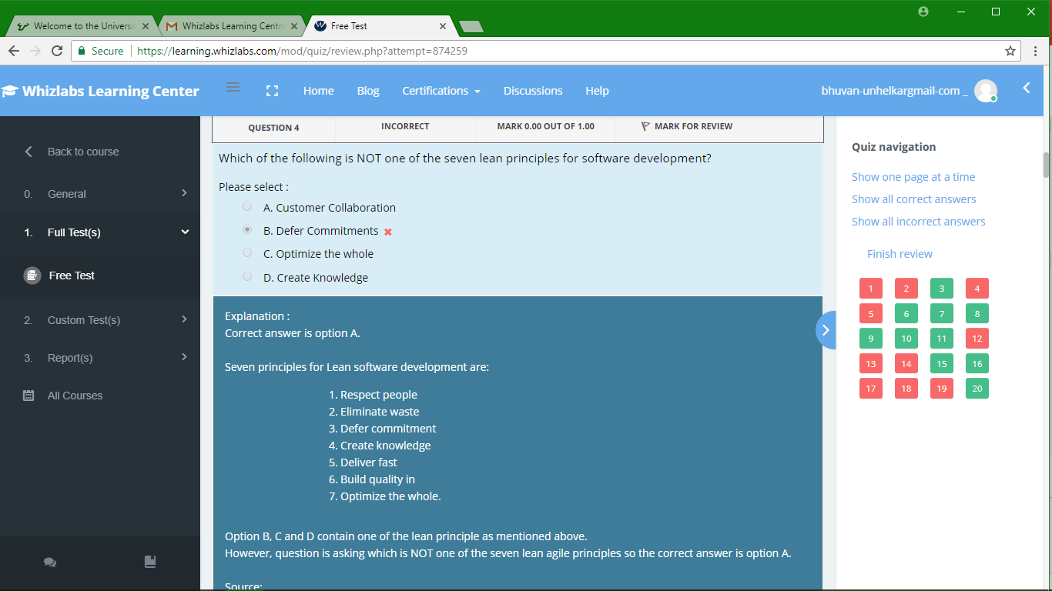

Slide 30
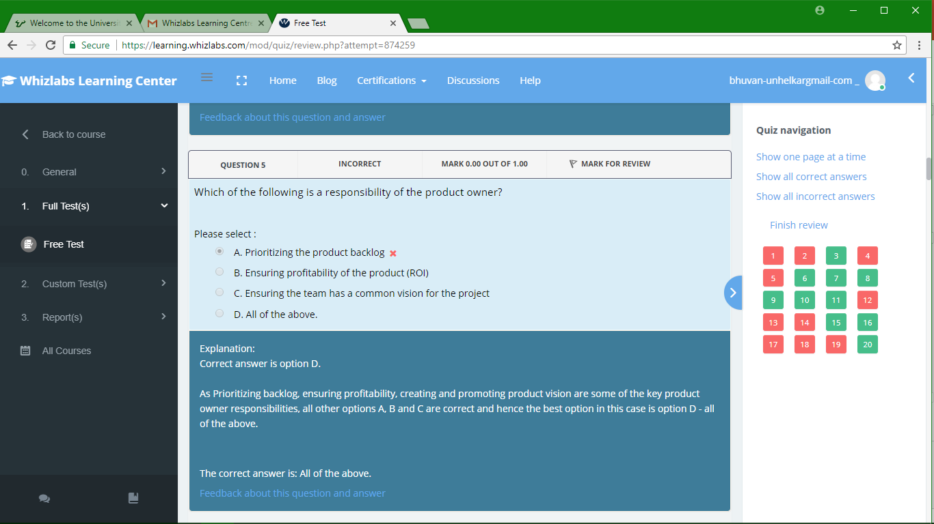

Slide 31
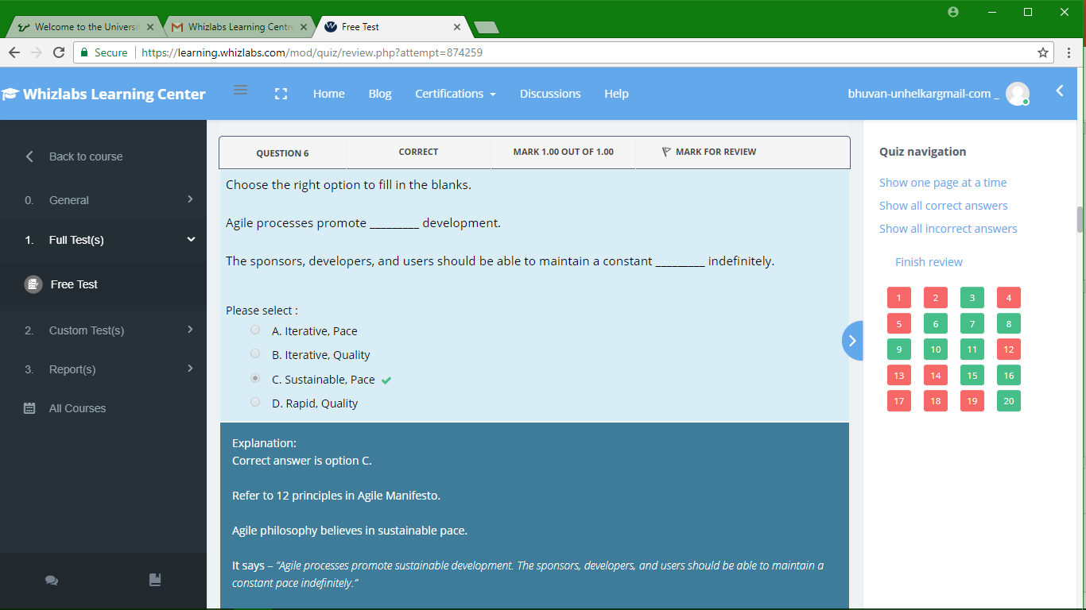

Slide 32
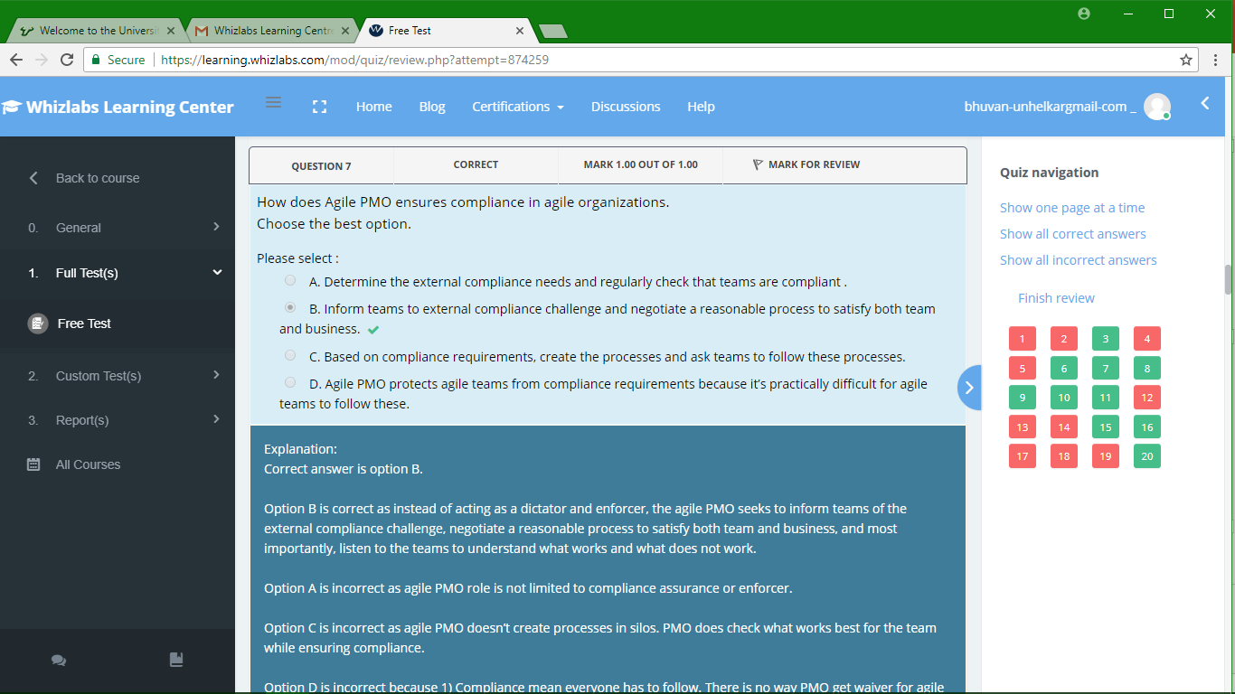

Slide 33
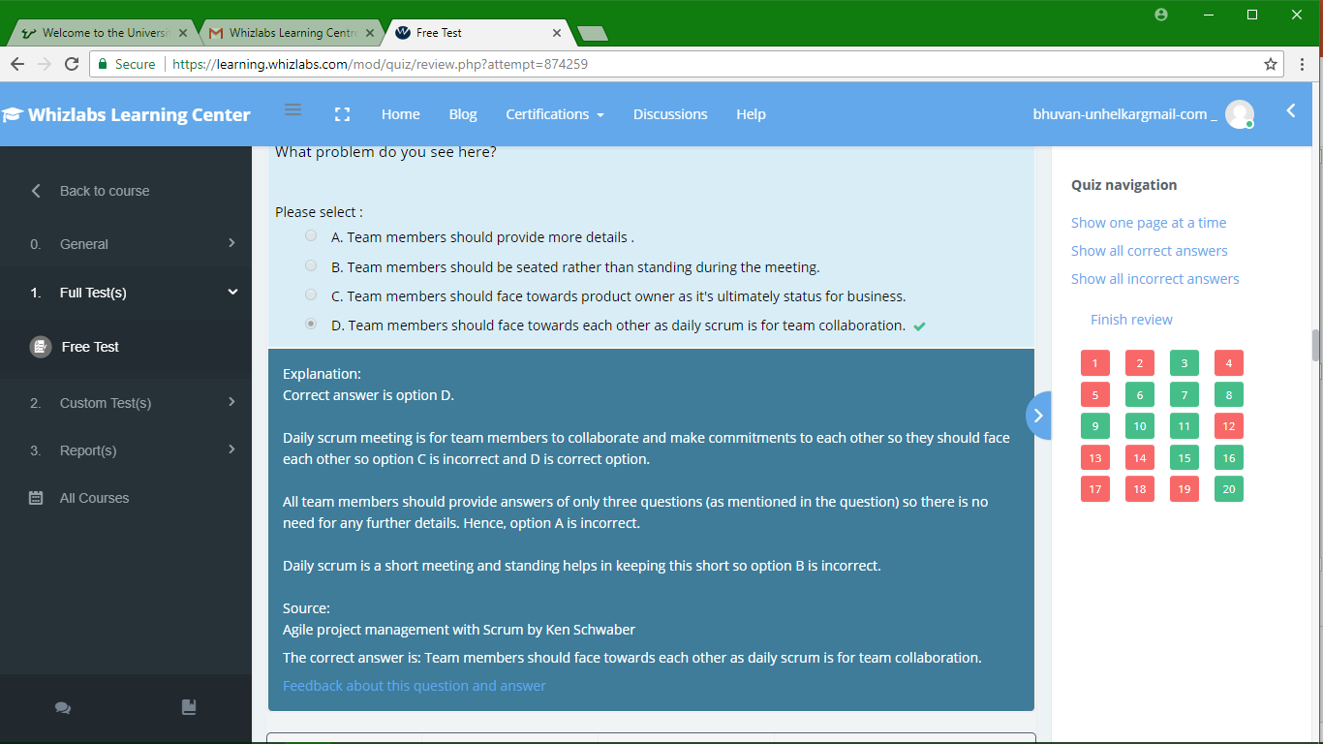

Slide 34
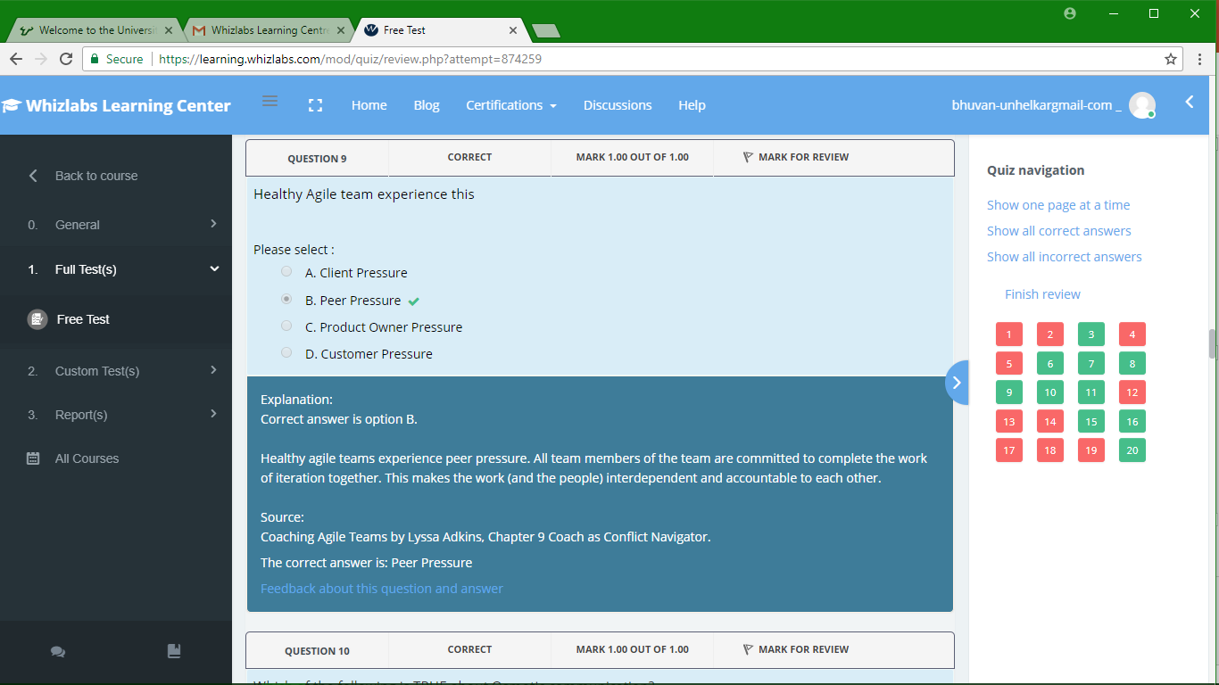

Slide 35
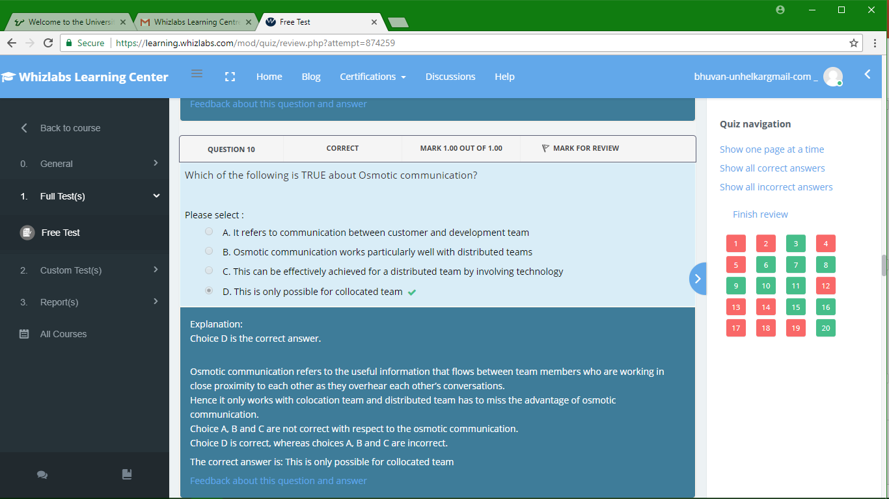

Slide 36
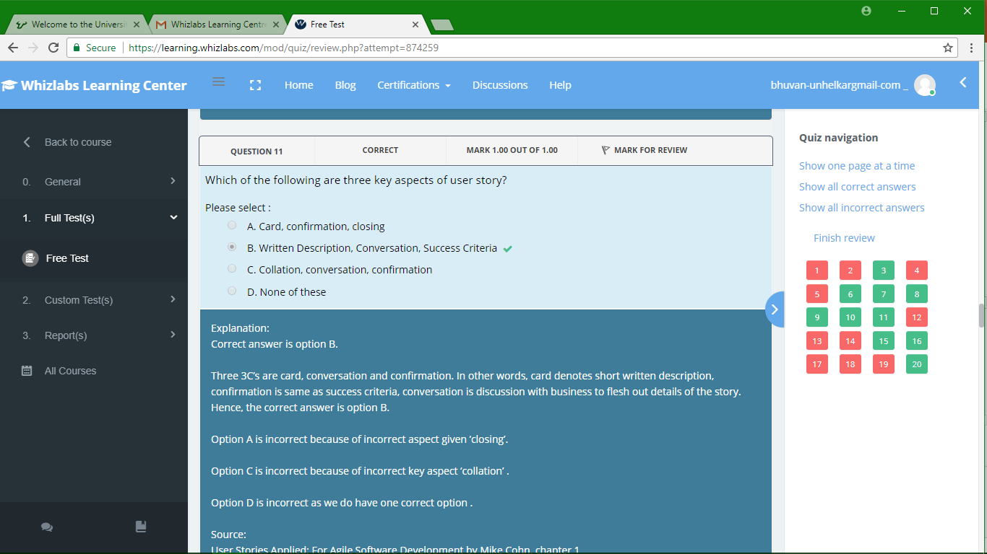

Slide 37
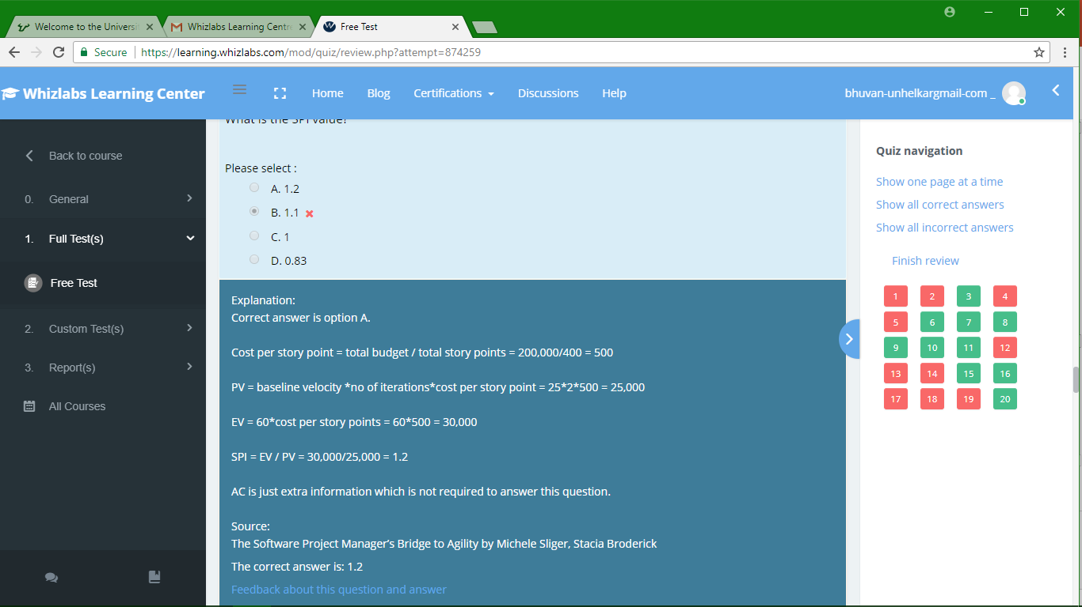

Slide 38
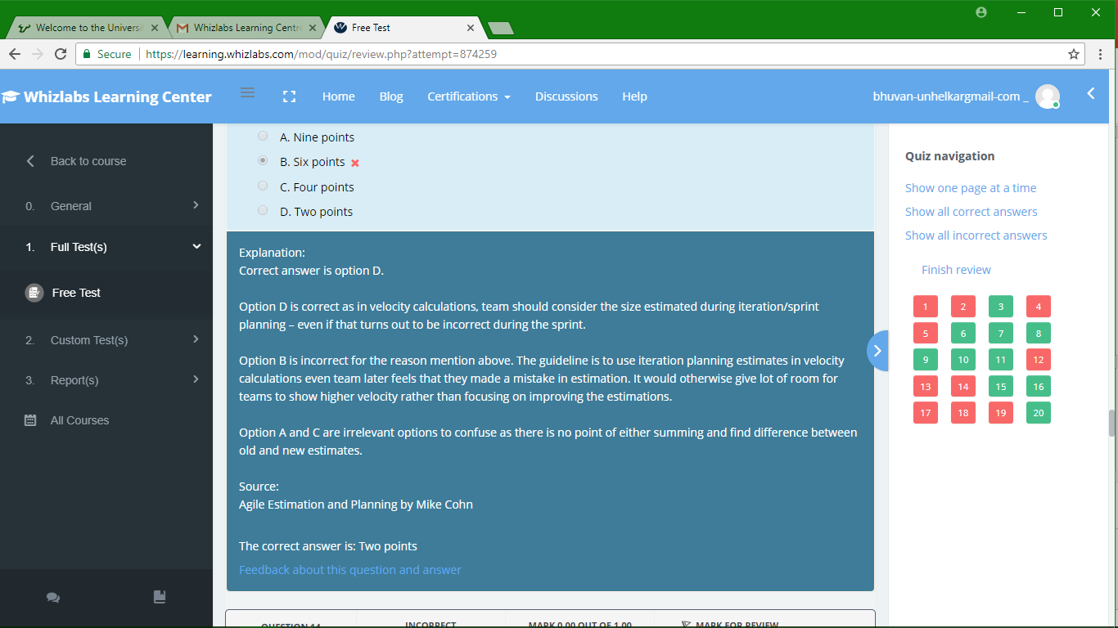

Slide 39
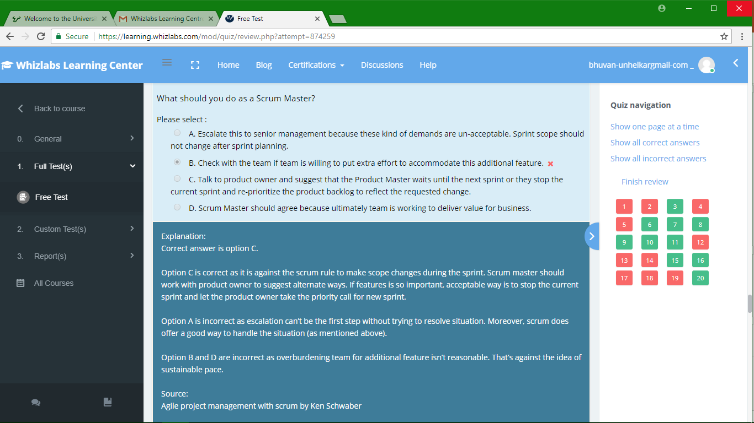

Slide 40
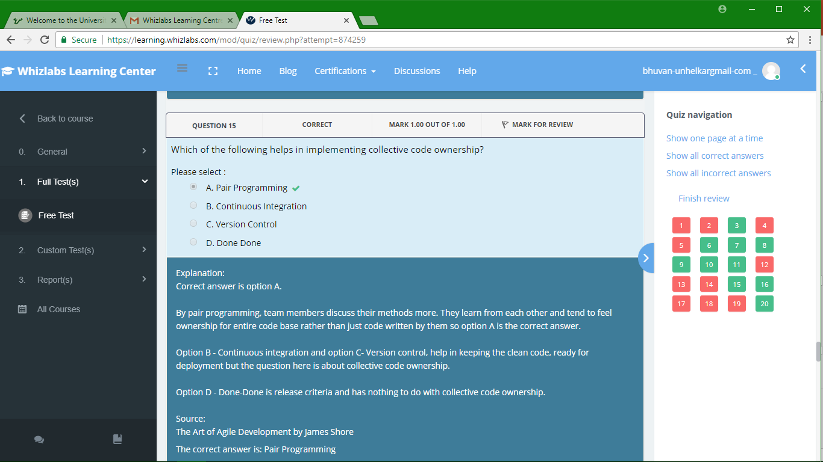

Slide 41
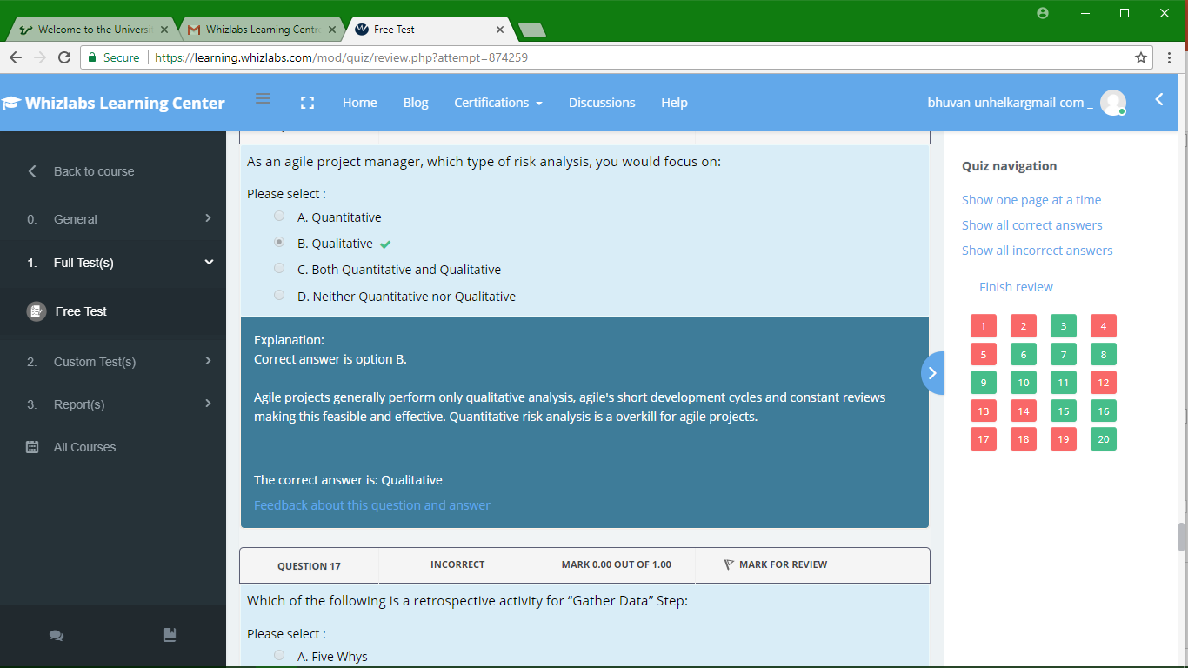

Slide 42
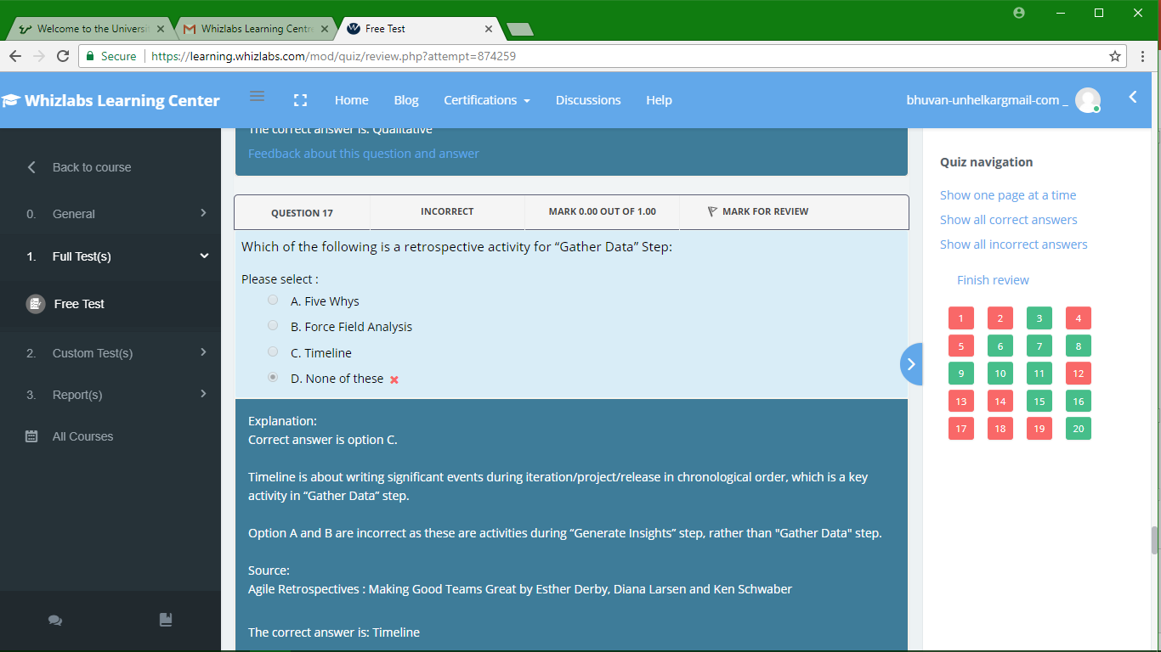

Slide 43
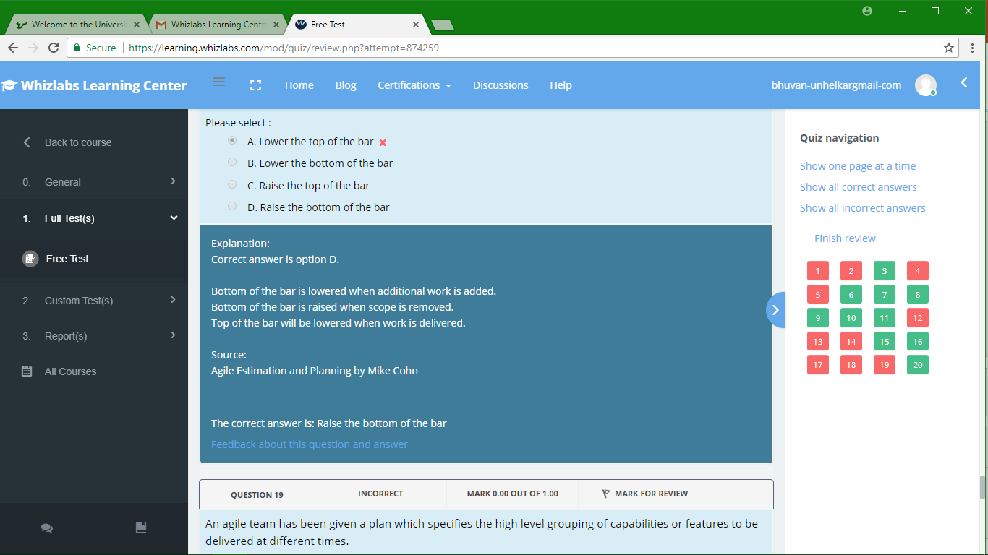

Slide 44
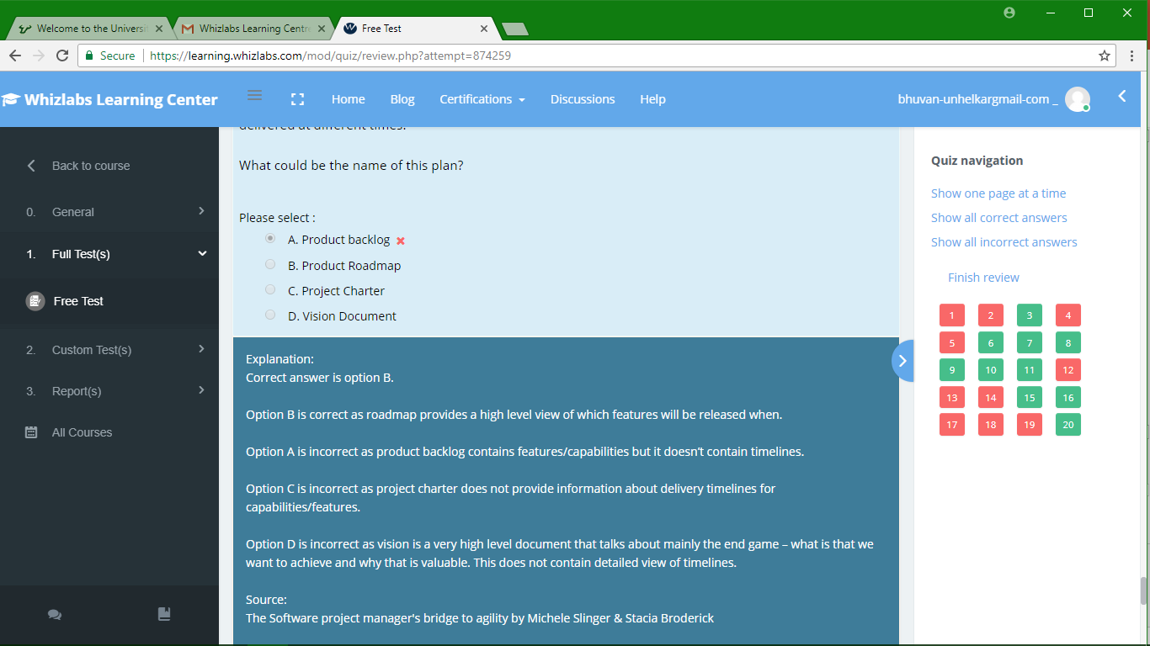

Slide 45
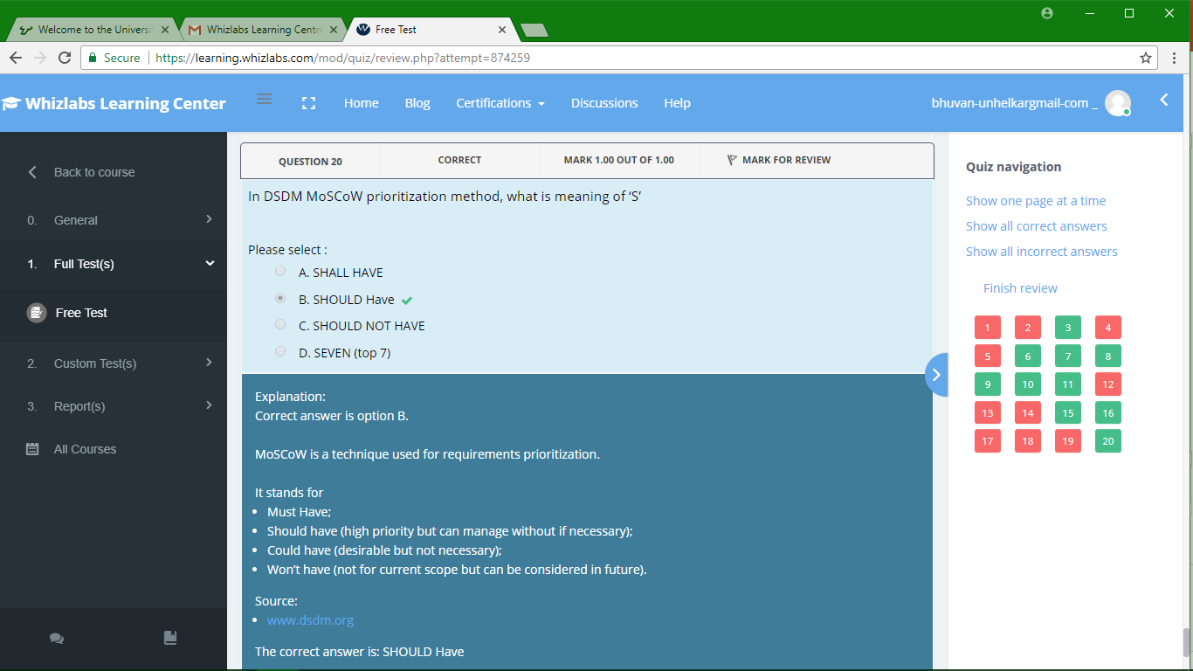

Slide 46
Sub-Module Agile Job Aids
And a Discussion Question
© MethodScience; Material Designed and Presented by Dr. B. Unhelkar

Slide 47
Sub-Module Agile Teams
Cross-Functional; Co-Located;
© MethodScience; Material drawn from The Art of Agile Practice (B. Unhelkar)

Slide 48
Team-Awesome
Evan Barniskis
Hasena “Stacy” Dukhi
Mary Helmle
John Holdway
Joel Lengyel

Slide 49
Team-Best
Michael Myers
Christopher Nothdurft
Nikki Orth
A Zahidur Rahman

Slide 50
Team-Champions
Stanley Abada
Rafael Adames
Sumner Darling
Yves Lexis
Mark Richman

Slide 51
Conclusions & Future Directions
We discussed…??
Do you see what we see?

